Slide 1
Presenter notes
Resources:
GitHub platform samples
Docs: Creating a template repository
Probot app: Prevent public repos
Probot app: Settings (config as code)
Docs: About protected branches
GitHub Marketplace
Platform samples: Jenkins script to protect main branch
GitHub Community: Forking vs branching
Docs: Classifying your repos with topics
Demo prep:
See 04_repo-and-policy-UI-walkthrough.docx
FAQ:
No specific FAQ slides, generally not many questions
Customer stories:
N/A
Expected timing:

Slide 2
Repository and policy management
GitHub Bootcamp
@presenter name (optional)

Slide 3
This module will enable you to:
Identify best practices for repository configuration and branch protection
Identify automation opportunities in managing repositories at scale

Slide 4
Agenda
A common enterprise scenario
Scaling policy as code
Protecting branches
Repository templates
Forking vs. branching
Repository topics
Organizing projects in a large org
Notes:
We've already gone through how to manage GitHub fundamentals from the both the developer and the manager perspective.
In the last session, the focus was organizations and teams and how they relate to each other.
GitHub can be incredibly secure if organizations, teams, and companies understand the capabilities:
Protected branches
Templates
Forking
Topics
Organizing projects in larger organizations
Let's talk about policy, and how to tie these features in a way that helps you to see the options.
Let's showcase the art of the possible inside of GitHub. Security doesn't mean you have to have any trade offs in administrative ease. In GitHub, you have options available to you.
********
Resources
https://help.github.com/en/github/setting-up-and-managing-organizations-and-teams/managing-organization-settings
https://help.github.com/en/github/administering-a-repository/managing-repository-settings
********

Slide 5
A common enterprise scenario

Slide 6

Common challenges in the enterprise
Notes:
A common scenario that we see with customers:
Organizations often want their repositories to have a certain visibility. (Ex: Internal or public as default.)
Automation can help here. If someone creates a repository outside of the policy, it is audited. You can get alerted. Not only can you see it and report on it, but you can actually actively be alerted on that.
A story
Imagine a situation where you don't have this reporting data at your fingertips as you manage your applications.
Imagine that you're slowly rolling out more open and transparent ways of working, and you get a ping on Slack about this reporting data.
But, you don't know where to find that data at the tip of your fingers. You don't know what the root cause of this report is. Maybe your application is down, or it is slow, or there's a local report that someone can't access the application.
How do you get that data? How do you solve that issue at its core? Are you using automation and Actions?
Access and visibility to things like GitHub Packages, release packages, the related issues, pull requests, commits, tests, labels, and milestones – all give you a leg up to find what you need.
It's one thing to not have access to this information.
It's another to have access, but still struggle to find it manually.
We recommend working towards automation to coordinate your relevant data points into your relevant systems, like ChatOps or monitoring dashboards.
********
Speaker tip:
Our customers often want to walk through their settings and configurations with us. This provides an opportunity to walk through each setting and discuss how it works, and when to use it, and it also provides a check-up to ensure they don't have any problematic configurations.
********

Slide 7
1 organization
Recommend one (1) organization
Multiple orgs only when benefits outweigh drawbacks
Manage at the organization level, not at enterprise account
Enterprises favor separating "open source" repositories from sensitive repositories
Notes:
GitHub's recommendation is one organization by default. Just about any workflow can work with one organization.
Why?
We recommend one org not because we disallow multiple organizations, but we really want to help customers simplify what they're doing & make their lives easier.
Reporting and visibility across organizations
Monitoring, reporting, troubleshooting is much more difficult when using multiple orgs.
If you can't clearly get to the root cause and quantify or qualify the report of the downtime easily, then you really need to look at how much time you might be spending on doing that manually, and that includes security, and that includes doing who's doing what.
Improved discoverability/Ability for others to easily contribute to other projects.
Managing configurations
Managing settings at the org level instead of the enterprise level provides more fine grain control for configuration. Often, if multiple orgs are actually necessary, the reasons that they are necessary require different configurations at the organization level.
Other context:
GHEC (GitHub Enterprise Cloud) especially lends itself to single org per enterprise, because Cloud is already hosted on the public GitHub com infrastructure.
Exceptions:
There are some niche use cases that make sense for multiple organizations, like mergers or contractor access, but they come with significant tradeoffs.
You may hear from customers:
"How do I actually organize everything I have a large divergent company built off of acquisitions over years."
"My company's been around for 75 years and the structure that we have in place today will never adapt to where you know we're looking to go going forward, and therefore we cannot innovate"
The goal is to have a conversation about this.
Try to turn the conversations into an exploration of possibilities.
Help the customer see that yes, it is possible to adapt your organization with a lot of different history inside of it.
How to do that?
Talk about what is possible
Leverage the API to address specific pain points
********
Resources:
https://github.com/github/platform-samples
https://resources.github.com/downloads/github-guide-to-organizations.pdf
*******

Slide 8

Recommended member permissions
Base permissions: | None
Repository creation: | Internal
Repository forking: | Disabled
Repository invitations: | Disabled
Repository visibility change: | Disabled
Notes:
This is GitHub's most recommended set-up. Start here, then have a conversation with teams to make any adjustments.
Base permissions: None
Control access with teams
Repository creation: Internal
Customers often have contractors who ideally shouldn't see each other's work.
Repository forking: Disabled
Disable forking by default, unless you really know what you're doing.
If forking is disabled, it is only allowed on public repositories.
This is also configurable at a repository level.
Repository invitations: Disabled
Keep that at the administrative level
If disabled, only organization owners can invite outside collaborators
Repository visibility change: Disabled
You don't necessarily want something private to become public, or something public to become private.
Ex: A public, open source repository is promoting your brand, like VS Code. There are downstream dependencies. Making this type of repo private could affect many people in a variety of ways.
Relatively new setting - "Internal" repositories, visible to all Org members
If disabled, only organization owners can change visibility after the repository is created

Slide 9
Scaling policy

Slide 10
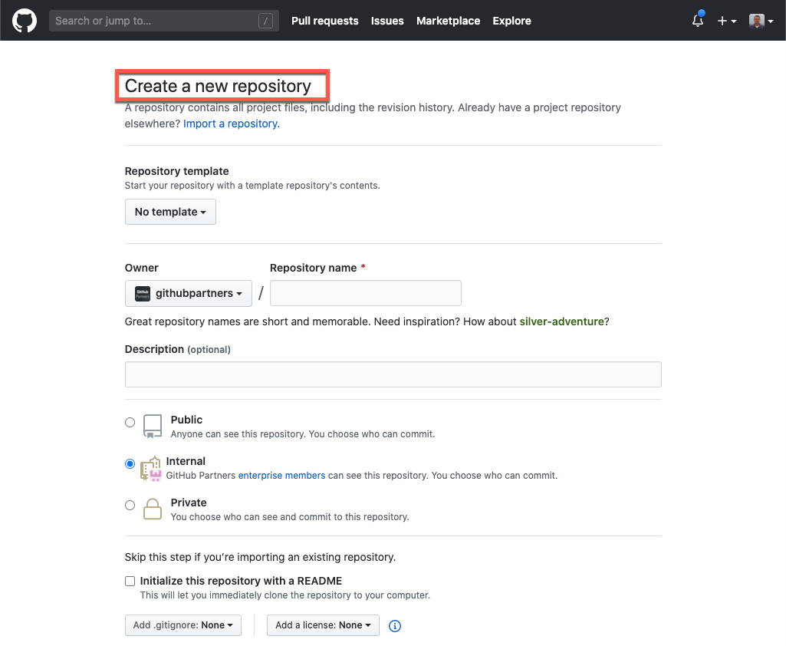
Repository creation
Notes:
When users create new repositories, they are faced with quite a few options.
Organizations may have guidelines or policies about these options
Administrators can do some things here, but instead of defaulting to restrictive, we recommend automation to enforce and encourage policy compliance at scale.
For example, hopefully we can all agree on the value of README files. Rather than restrict who can create repositories to prevent poorly documented repositories, use automation. (We'll talk about some examples shortly.)
Resources: https://github.com/new

Slide 11

Repository templates
Notes:
You can make an existing repository a template, so you and others can generate new repositories with the same directory structure, branches, and files.
Whenever you use the template, new repositories are created with the same directory structure, branches, and files.
Issues and pull requests do not come over. What you're actually doing is putting in place the code as policy for that repository.
Template repositories can include other policies as code, like a contributing guide, .gitgnore, issue templates, or other configuration files
Template repositories can also include workflow files – which means automation will already be in place for new repositories. Attach automation on the back side. Examples of this could be:
An action that triggers a new issue immediately after the repository is created, reminding the creator to check or configure certain settings at the repository level.
An action that opens an issue with contact information for the administrator or an internal GitHub adoption team
If you focus on policy and infrastructure as code, all of the above is code.
Really easy to scale.
********
Resources
GitHub Docs: Creating a template repository https://docs.github.com/en/github/creating-cloning-and-archiving-repositories/creating-a-template-repository
********

Slide 12
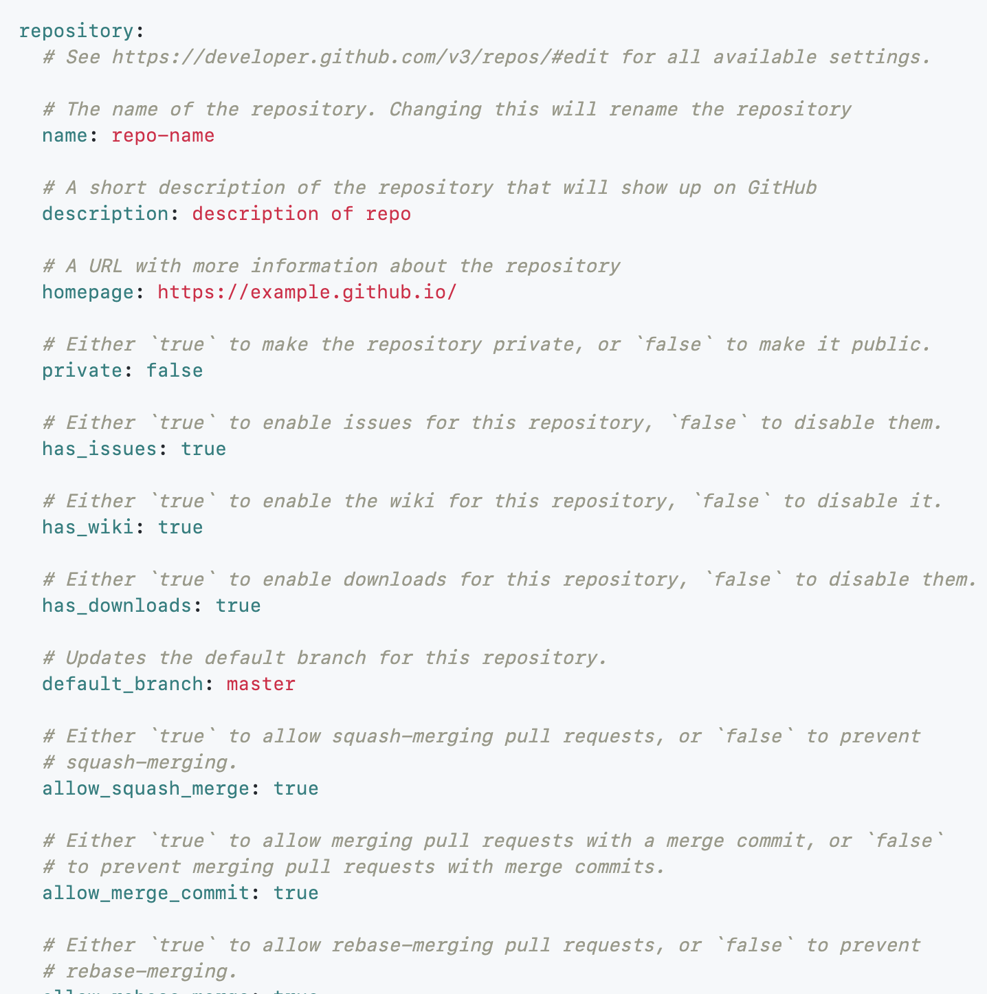
Policy as code
Use dotfiles in templates
Control repository settings and access management
Manage policy with automation
Use with protected branches & codeowners
Notes:
We have seen enterprises use one or more 'dot' files and templates to control repository settings.
GitHub has a lot of built-in features (like issue templates) accessible via the UI and configurable as code. (We will look at an issue template example as a JSON file shortly.)
The message is clear – a combination of codified policy plus automation is the best for scaling policy compliance
The screen shows functionality that is enabled with third-party apps.
This is a simple GitHub settings yml file.
All of these settings are in the UI in the settings tab.
Putting these settings as code is incredibly scalable and powerful.
By storing settings as code, you open those settings up to automation for things like audits, or even automated changes via PR.
This will work whether you have 15 or 1500 repositories.
Since it is code, it is in Git version control.
Customer application:
How many repositories do your customers have?
Do they know what the settings are in each repository?
Do they know what settings should be enforced across those repositories?
You know who changed what, and when
You have an app to monitor manual changes
********
Resources
Third party example: Probot app: Settings https://probot.github.io/apps/settings/
********

Slide 13
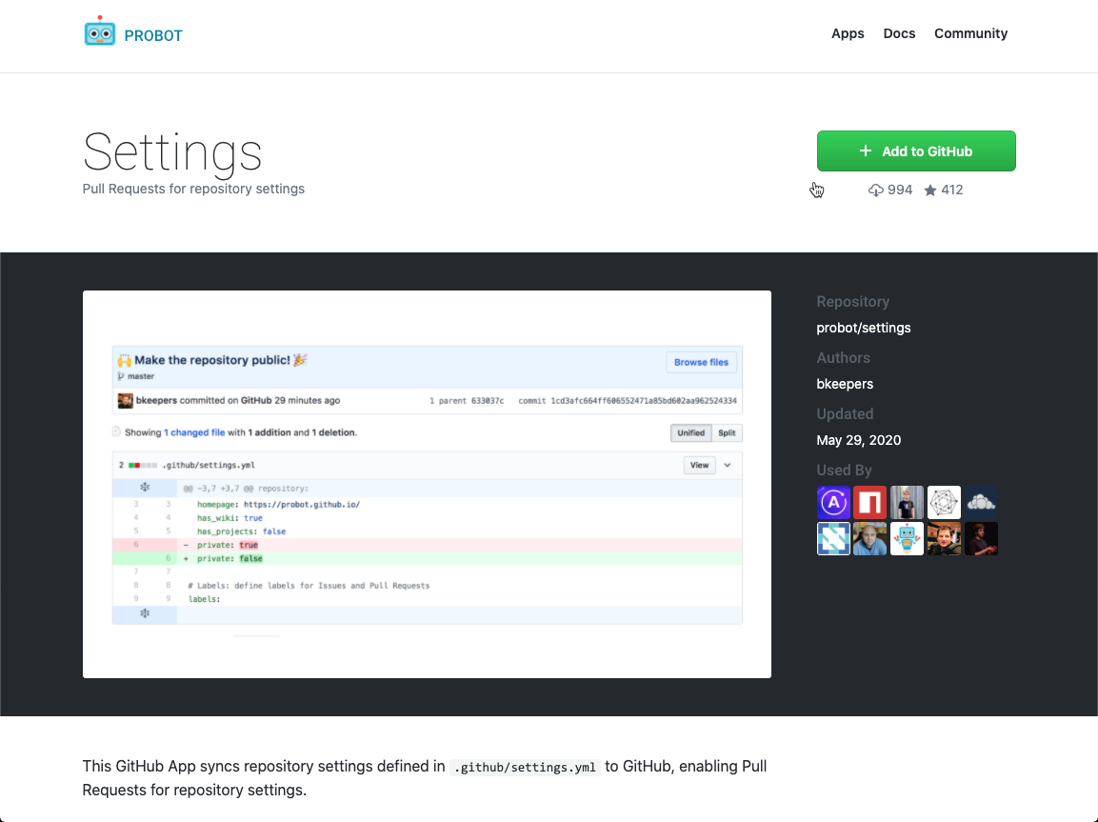
Manage repository settings
https://probot.github.io/apps/settings
Notes:
This GitHub App syncs repository settings defined in .github/settings.yml to GitHub, enabling pull requests for repository settings.
If you look really closely at this slide, you can see that the lines of code in this settings file match the settings in your repository settings. (Let's look in more detail on the next slide)
********
Resources
Probot app: Settings https://probot.github.io/apps/settings/
********

Slide 14
One method to scale policy
Use a GitHub App
Listen for the new repository creation event
Apply settings
Notes:
There are always tradeoffs, but when setting policies, optimize for scalability and accessibility.
One way to do this is through additive application that listens for the new repository creation. Now you can kickstart automation to do more, even if users don't use template repositories. Examples:
Enforce a description by notifying repository owners with an issue
Audit repository settings on a recurring cycle, and open issues/notify if something is divergent
Actively listen to certain events (like changing repository visibility) and audit, block, or revert the changes automatically
GitHub uses an entitlements repository and pull requests to manage access to critical systems

Slide 15
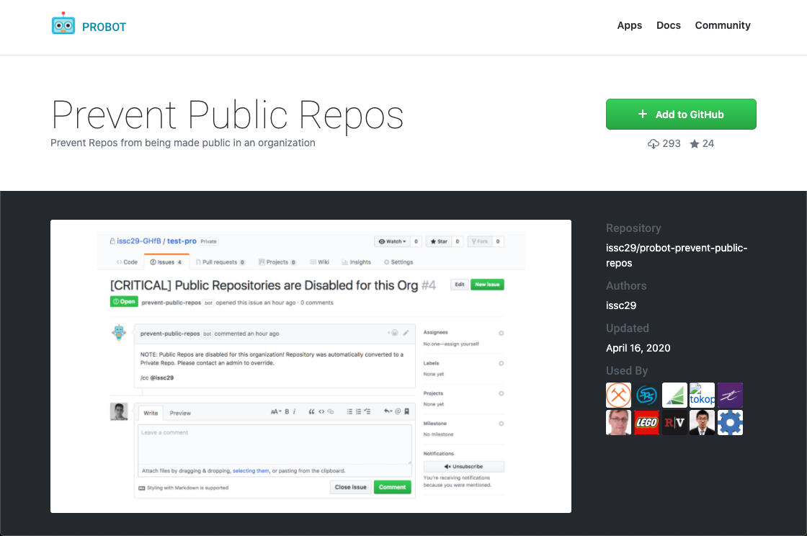
Prevent public repositories
https://probot.github.io/apps/prevent-public-repos/
Notes:
This app is a great example of scaling policy with automation
Prevents public repositories
Listens for the repo creation event and takes action
*******
Resources:
Probot app: Prevent Public Repos https://probot.github.io/apps/prevent-public-repos/
********

Slide 16
Protect branches

Slide 17
About protected branches
Protect certain branches
Many options for requirements
Doesn't affect branch creation
Notes:
Protected branches ensure that collaborators on your repository cannot make irrevocable changes to branches. Enabling protected branches also allows you to enable other optional checks and requirements, like required status checks and required reviews.
Protected branches don't affect branch creation. Branches can and should still be used for ideas and experimentation.
GitHub experience: As we work with many organizations coming from other version control systems (Garrett being with the most obvious ones), they needed the ability for administrators to block pushes. It could have terrible reversible consequences if you don't protect the default branches under the right conditions and this feature is very widely used.
********
Resources
GitHub Docs: About protected branches https://docs.github.com/en/github/administering-a-repository/about-protected-branches
********

Slide 18
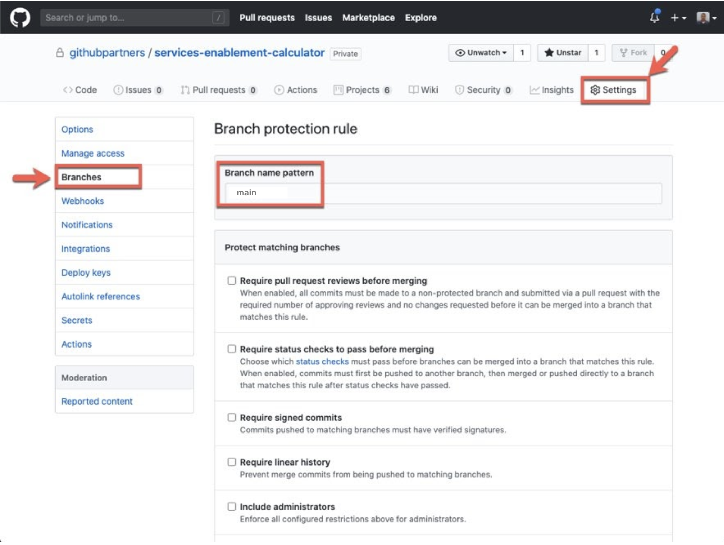
Implement branch protection
Repository settings
Admins only
Name pattern options
Limit merging & committing, not creating
Notes:
This is how you do implement protected branches.
When you go into the repository, go to the Settings tab.
Go to branches and you can actually put a regular expression matching a branch name and apply rules to that branch.
But in order to get that to merge into your default branch or whatever branch you specify in this list, it has to pass these conditions.
It's helpful for developers to know that yes they can create a branch. They can experiment and they can messed up and fail. That is okay because we have the default branch protected.
********
Speaker tip:
During the UI walkthrough at the end of this session, enable protected branches and talk through the different options that can be enabled.
*******

Slide 19
Thoughts on branch protection
Protect the default branch
New and existing repositories
Leverage automation
Notes:
It is very common for enterprises to protect the default branch of each new and existing repository automatically. To accomplish this, leverage GitHub apps as well as Actions to accomplish branch protection. There are plenty of GitHub apps that can listen for repository creation.
Find these applications at github.com/marketplace.
Vast majority of apps have associated code repositories and are free to edit, customize and even run locally.
Alternatively, if you have a server on premise instance of GitHub Enterprise, use your existing CI system to listen for repository creation events.
********
Resources
Find many apps and actions in GitHub Marketplace: https://github.com/marketplace
********

Slide 20
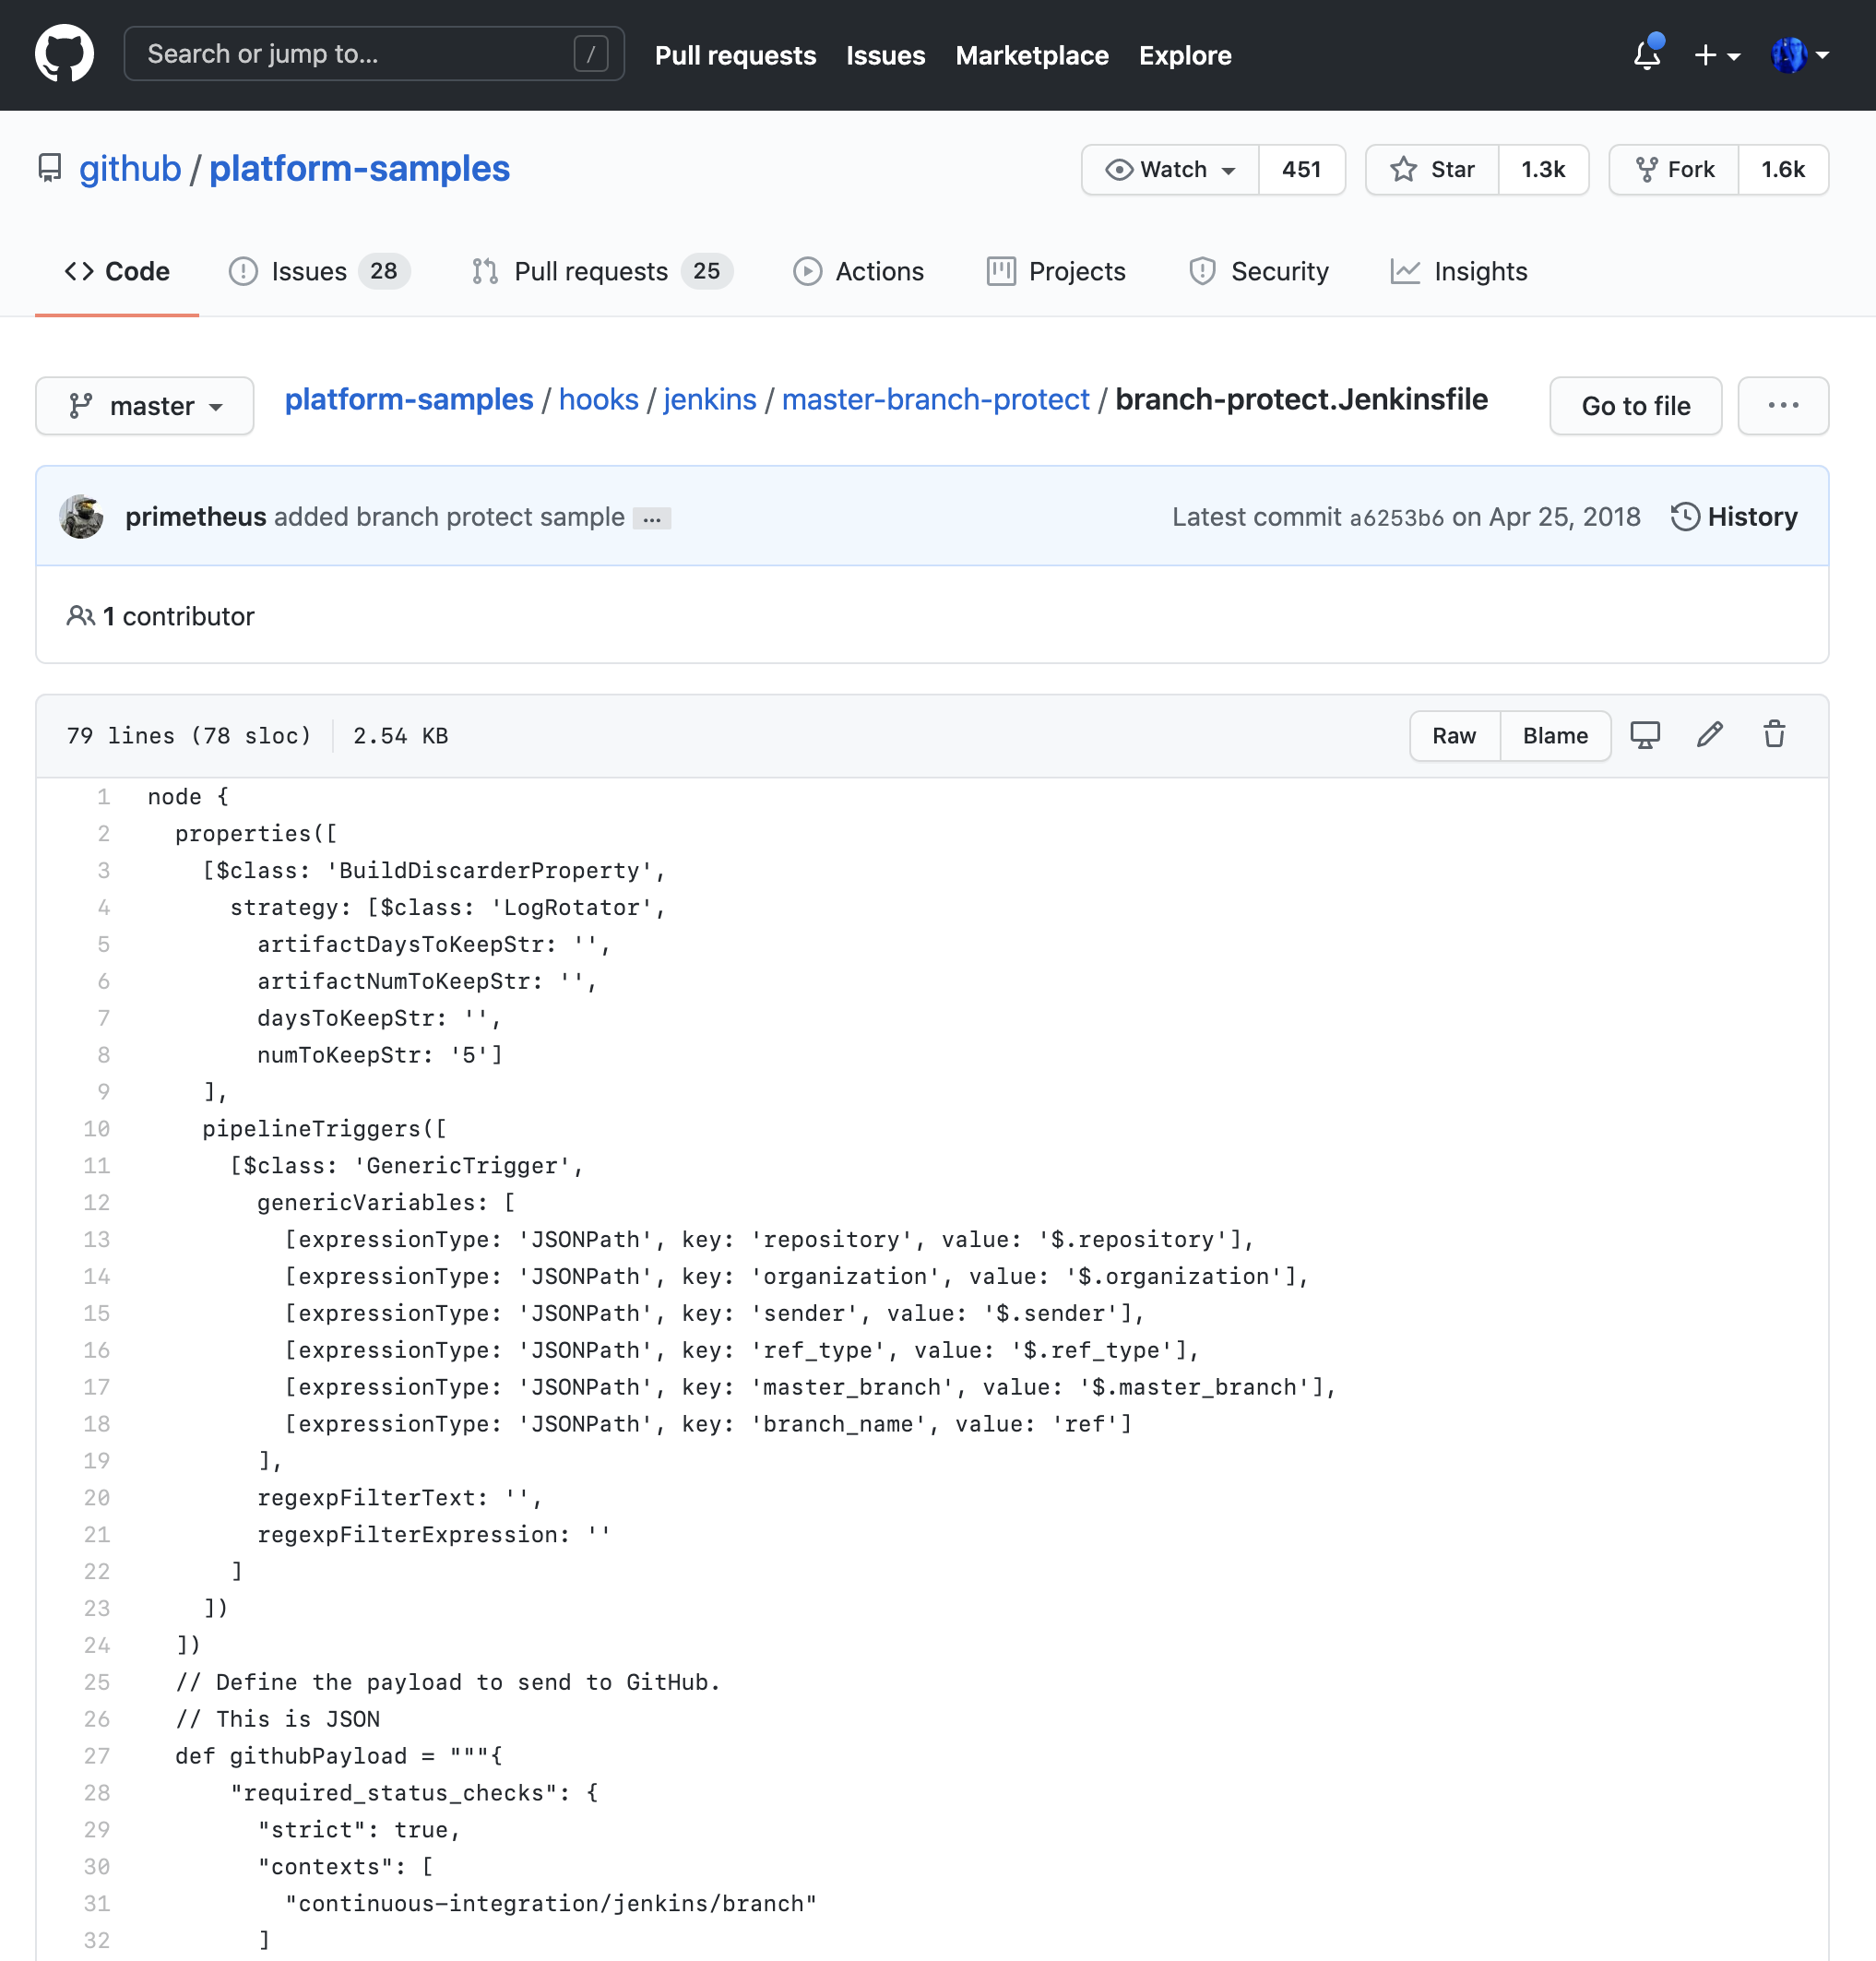
Automatic branch protection
Notes:
Listen for the repo creation event
Use your existing CI system
Example with Jenkinsfile
There are plenty of simple GitHub Apps that can listen for the repo creation event, then protect the branch
You can use your existing CI system to listen for repository creation events, then process applying the settings
A more comprehensive example using a Jenkinsfile can be found in our Platform Samples repository
This is GitHub's public, open source, platform-samples repository
An excellent resource, strongly encourage you to be familiar with what is available
This particular example is a Jenkins workflow file that you can import into your instance to make sure the default branches are always protected
*******
Resources
Platform Samples: Jenkins script for protecting the default branch https://github.com/github/platform-samples/tree/master/hooks/jenkins/master-branch-protect
********

Slide 21
Forks vs branches

Slide 22
Know when to branch and fork
Considerations & complications
Access management
Branch when possible
When forking is necessary
Notes:
When to fork? When to branch? What to consider? Highlight that forking should be disabled as a best practice.
Access management
Address concerns by protecting branches and automating policy enforcement, rather than restricting branching.
Generally speaking, default to branching.
You can use branches almost* freely
Branches allow you to experiment, try out ideas, sample test, and sample build
There are some use cases when forking is preferable to branching.
When it's necessary for access for contractors or outside collaborators
Public, open source projects
Downsides of forking when branching should be used
Confusing PR experience
Confusion on "source of truth"
Discouraging contributions implicitly
********
Resources
GitHub Community Forum thread on Forking vs Branching https://github.community/t/branch-vs-fork/1206
********

Slide 23
Repository topics

Slide 24
Group repos with topics
App
Database
IT
services
Notes:
To help other people find and contribute to your project, you can add topics to your repository related to your project's intended purpose, subject area, affinity groups, or other important qualities.
Because we recommend one organization, we'll often asked "I might have 1000 repos in here. How do I really narrow down what I'm looking at?"
There are several ways.
Naming convention is one. This is not our first recommendation, because it is difficult to enforce and maintain.
Repository topics are more tangible
Topics are applied to repositories, regardless of repository name.
Ex: Maybe you have a topic called app or database right to services
These are similar to labels on an issue.
Repositories can be filtered by topic.
********
Resources
GitHub Docs: Classifying your repository with topics https://docs.github.com/en/github/administering-a-repository/classifying-your-repository-with-topics
********

Slide 25
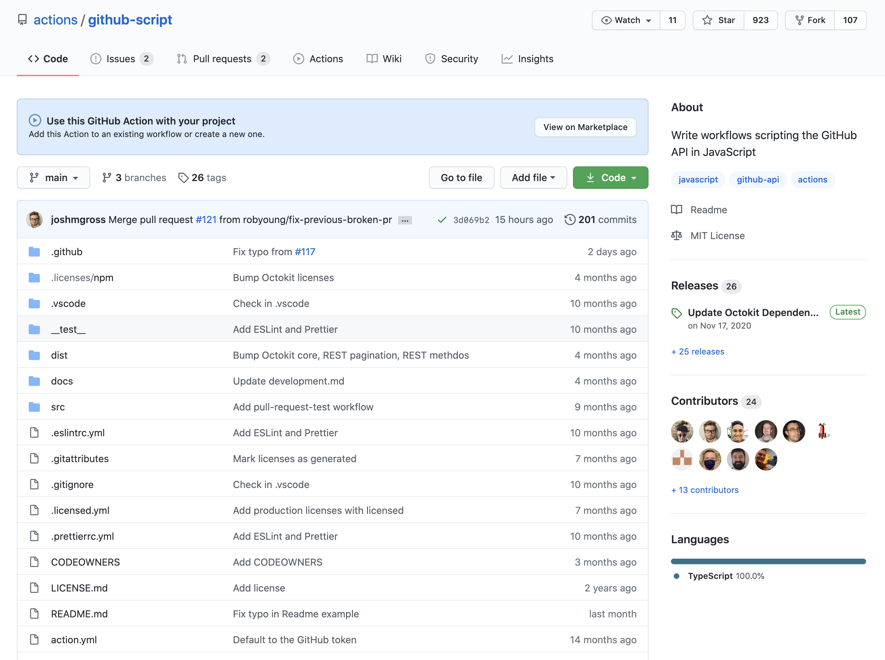
https://github.com/actions/github-script
Notes:
This is how repository topics look.
You can add more, or you can add less. You can really customize which ones are applied to any repository.
Many organizations have a default set of topics that they like to add in their organization or in their repository list.

Slide 26
Organize projects in a large organization

Slide 27
Organize projects in a large organization
Topics
Naming conventions managed by policy apps
Team repositories linking out to a team's relevant repos
Team repositories tab
Notes:
We've discussed topics and naming conventions
Team repositories are an example of a different type of repository.
Instead of being a repository for code or an application, a team repository can house team documentation.
This may include a README that explains who the team is, what they work on, and links to their most relevant repositories and resources.
It is helpful to have a template, so these team repositories are standardized and discoverable by topic
The team repositories tab is a way to view repositories, regardless of topics, that a specific team has access to.
Find your team page by going to your org page and clicking "teams"
Then click "Repositories"

Slide 28
UI walkthrough
Notes:
Please see the walkthrough document for this module

